Slide 1
CAPSTONE PROJECT: Medical Insurance Analysis
CAPSTONE PROJECT PRESENTATION
Shah Genom Abdullah (u3239568@uni.canberra.edu.au)
Ayman Ahmed (u3236372@uni.canberra.edu.au)
Tutorial: Thursday 09:30 am

Slide 2
Table of Content
Introduction
Dataset Details
Exploratory Data Analysis
Predictive Data Analytics
Implementation and Deployment
References

Slide 3
Introduction
In our capstone project we have done EDA AND PDA on medical insurance data.
The goal of this project is to gain insights on the BMI(Body Mass Index) of individual, through their medical insurance data.

Slide 4
Dataset Details
The dataset was obtained from Kaggle
The dataset contain information such as BMI, Charges, Children, Smoke, Region, Sex, and Age.
The dataset has 2772 rows and 7 columns

Slide 5
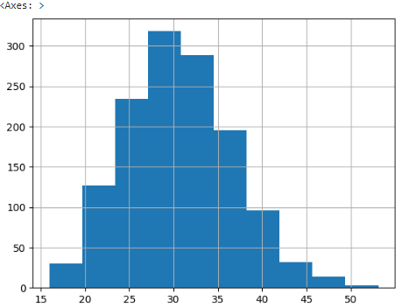
Picking the target variable
Histogram of BMI, the Y-axis is the frequency and the X-axis is the BMI
The graph is a bell curve, therefore all good to pick it as the target variable

Slide 6
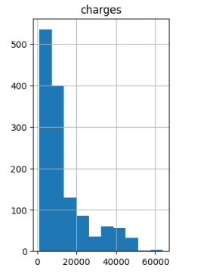
Other columns such as Charges were too skewed.

Slide 7
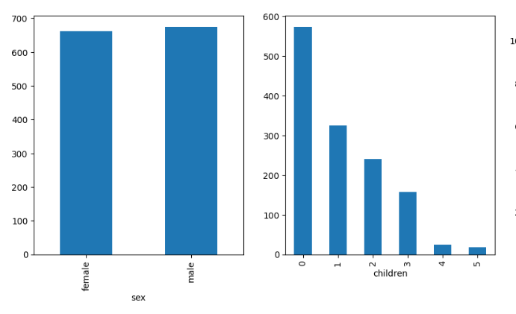
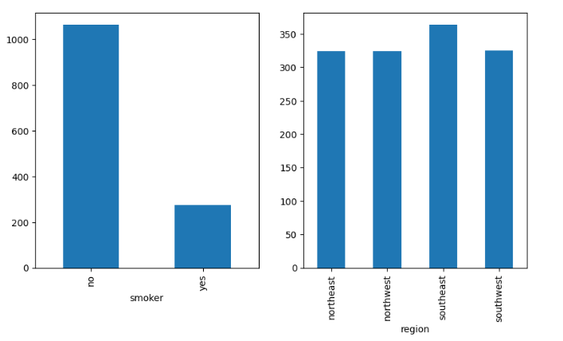
Categorical columns
Using bar charts to observe distribution of the categorical predictors.
In the bar charts there does not seem to be skewed distributions where one column is higher than the rest.
The children and smoker graphs maybe be skewed
More analysis in correlation section

Slide 8
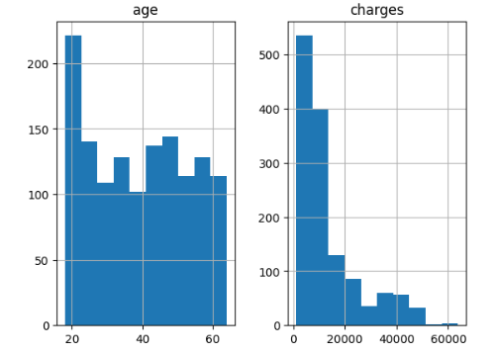
Continuous columns analysis
- Both columns seem are a skewed, Charges is more than Age
- If the data is skewed than that column need to be removed.
- We will do further analysis before removing the columns.

Slide 9
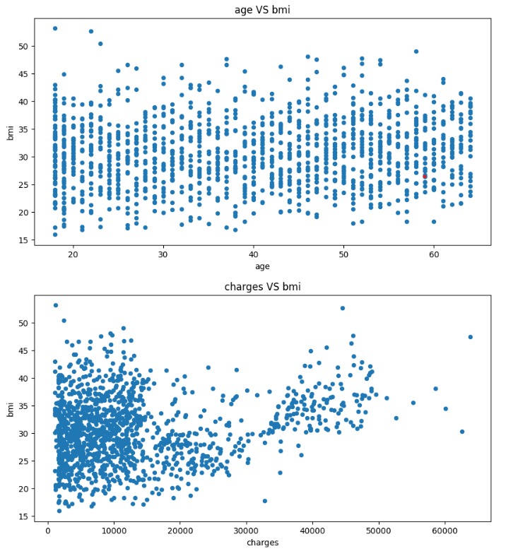
Target variable VS continuous columns
Visualising the relationship between BMI and both Chagres and Age as they are all continuous.
The age against bmi chart does not seem to have any trends
The charges against bmi chart seem to almost have a positive trent.

Slide 10
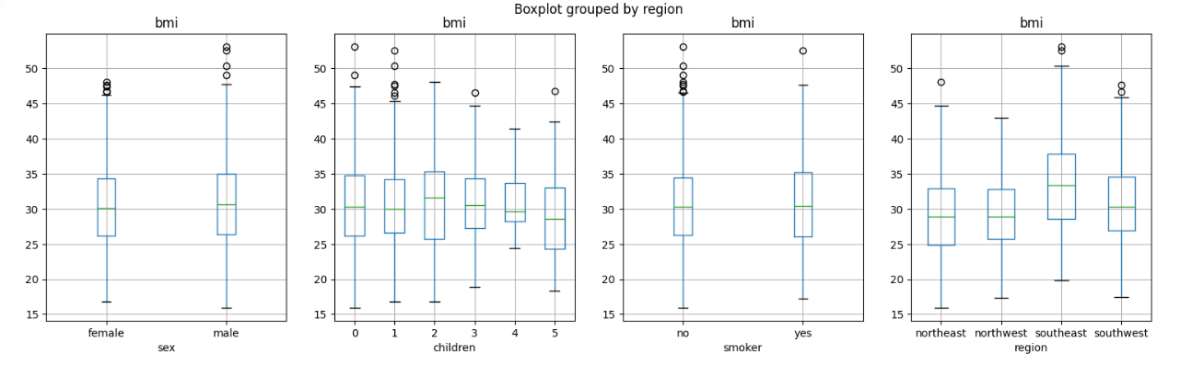
Relationship between categorical and BMI
BMI by Sex:
Similar median BMI for both sexes.
Minimal difference, indicating low impact of sex on BMI.
BMI by Region:
Noticeable differences in BMI distribution by region.
Southeast shows higher median and greater variability.
BMI by Number of Children:
Stable median BMI across groups.
Slight increase in variability with more children.
BMI by Smoking Status
Comparable BMI medians for smokers and non-smokers.
Smoking status shows little influence on BMI variation.
Next Steps
Conduct an ANOVA test to statistically confirm the influence of these categories on BMI.

Slide 11
ANOVA Results - Final selection
Why Conduct ANOVA?
Determine relationship between target and categorical predictor.
Null hypothesis (H0): No significant correlation.
ANOVA Testing Observations:
'Region' variable correlates with target.
Need for multiple columns for robust model.
Final Column Selection:
Include all <0.05 significance columns.
Similar ANOVA results across other columns.
Selection: 'sex', 'children', 'smoker', 'region'.
Model Enhancement:
Comprehensive inclusion improves predictive power.
##### ANOVA Results #####
sex is NOT correlated with bmi | P-Value: 0.8991704324920163
children is NOT correlated with bmi | P-Value: 0.8830491274520269
smoker is NOT correlated with bmi | P-Value: 0.8911471317224385
region is correlated with bmi | P-Value: 1.9087293927440606e-24
['region']

Slide 12
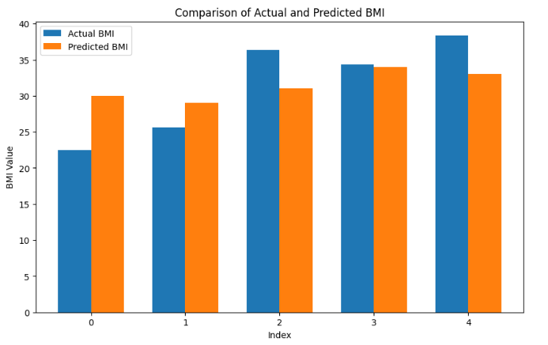
Predictive Data Analytics
I built a Random Forest Regressor predicts the BMI using medical insurance information.
The bar charts show the prediction for 4 tests blue being the actual BMI and orange is the Predicted BMI.
Based on the model the BMI for person 4 is 33.
The model has average accuracy of 85.49.

Slide 13

Implementation and Deployment
I used Tkinter to build an app which implements the data collected.
I used Pandas to manipulate data and analyse it and MatPlotLib to visualize the data.

Slide 14
Thank you!

